Slide 1
public class CalculatePay {
double dPay; int iHours;double dRP = 0.0;
final int iWEEKLYHOURS = 40;
final double iBASEPAY = 8.0;
final int iMAXHRS = 60;
final double dOTR = 1.5;
CalculatePay(int iHours){
this.iHours = iHours;
}
void findPay() {
int iEH =0;
double dEP = 0.0;
if(iHours > iMAXHRS){
JOptionPane.showMessageDialog(null, "Too High Hours"); }
else if(iHours > iWEEKLYHOURS) {
iEH = iWEEKLYHOURS - iHours;
dEP = iEH * dOTR * iBASEPAY;
dRP = iBASEPAY * iWEEKLYHOURS;
dPay = dEP + dRP;
}
else{
dPay = iBASEPAY * iHours;
}
JOptionPane.showMessageDialog(null, dPay);}
public static void main(String[] args) {
// TODO code application logic here
??????????
??????????
}
}
Foo Corporation needs a program to calculate how much to pay their employees.
*Pay = hours worked x base pay
*Hours over 40 get paid 1.5 the base pay
*The base pay must be no less than $8.00
*The number of hours must be no more than 60

Slide 2
Fibonacci Series Program
public static void main(String[] args) {
// TODO code application logic here
int next = 1;
int prev =1;
for (int i=0; i<10; ++i) {
next = next + prev;
prev = next-prev;
System.out.println(" " + next);
}
}

Slide 3
Lect# 5, Arrays
An array is an indexed list of values.
You can make an array of any type int, double, String, etc..
All elements of an array must have the same type.

Slide 4
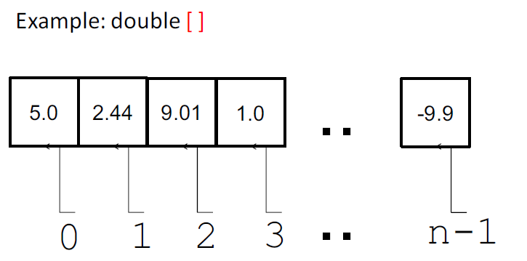

Slide 5
num[0] = 7;
num[1] = 3;
num[2] = 8;
num[3] = 1;
num[4] = 9;
num[5] = 2;
num[3] has value 1
The index can be a variable:
int x = 2;
so num[x] has value ?
num:
7
3
8
1
9
2
[0] [1] [2] [3] [4] [5]
first position is always 0
position of element
in the array
last position is always length-1

Slide 6
The index starts at zero and ends at length-1.
Example:
int[] values = new int[5];
values[0] = 12; // CORRECT
values[4] = 12; // CORRECT
values[5] = 12; // WRONG!! compiles but
// throws an Exception
// at run-time

Slide 7
An array is defined using the statement :
TYPE [] identifier
Arrays are just another type.
int[] values; // array of int
int[][] values; // int[] is a type

Slide 8
To create an array of a given size, use the operator new :
int[] values = new int[5];
or you may use a variable to specify the size:
int size = 12;
int[] values = new int[size];

Slide 9
Array Initialization
Curly braces can be used to initialize an array.
It can ONLY be used when you declare the variable.
int[] values = { 12, 24, -23, 47 };
Is there an error in the following code?
int[] values = {1, 2.5, 3, 3.5, 4};

Slide 10
Accessing Arrays
To access the elements of an array, use the []operator:
values[index]
Example:
int[] values = { 12, 24, -23, 18 };
values[3] = 18; // {12,24,-23,18}
int x = values[1] + 3; // {12,24,-23,18}

Slide 11
The length variable
Each array has a length variable built-in that contains the length of the array.
int[] values = new int[12];
int size = values.length; // 12
int[] values2 = {1,2,3,4,5};
int size2 = values2.length; // 5

Slide 12
Looping through an array
Example 1:
int[] values = new int[5];
for (int i=0; i<values.length; i++) {
values[i] = i;
int y = values[i] * values[i];
//Is declaration of ‘y’ correct inside the loop?
JOptionPane.showMessageDialog(???y);
}

Slide 13
Looping through an array
Example 2:
int[] values = new int[5];
int i = 0;
while (i < values.length) {
values[i] = i;
int y = values[i] * values[i];
JOptionPane.showMessageDialog(???y);
i++;}

Slide 14
Passing Array to Method
int [ ] num = {1, 2, 3}; testingArray(num); //Method call System.out.println("num[0] = " + num[0] + "\n num[1] = " + num[1] + "\n num[2] =" + num[2]);
//Method for testing public static void testingArray( int[ ] value) { value[0] = 4; value[1] = 5; value[2] = 6; }

Slide 15
import java.javax.swing.*; public class FindSum { public static void main (String [ ] args) { int [ ] number = new int [ 10]; //instantiate the array int i; int sum=0;
for ( i = 0; i < 10; i++ ) // fill the array
number[ i ] = JOtionPane.showInputDialog("Enter number: " ); //ERROR
int sum = find_sum(number); //ERROR
// invoke the method System.out.println("The sum is" +sum + "."); }
public int find_sum( int [ ] value)
//method definition to find sum { int i, total = 0; for(i=0; i<10; i++) { total = total + value[ i ]; } return (total); }

Slide 16
Array Programs. Implement methods for each
of the following task and pass array as an
argument. Invoke methods from main.
Find the sum of all elements of array
Find the largest element of array
Find whether the array element is prime or
not

Slide 17
Array Searching and Sort Algorithms (Bubble Sort)
Searching Unsorted Array
Imagine we had the following array of integers
2 4 1 5 6 3
At the moment this is an unsorted array.
The only way to search such an array is to start at the top and check each item in turn until either the value sought is found or the end of the array is encountered.
Difference Between Binary Search and Linear Search
Advantage of Menu Driven Programming Using while-switch-case

Slide 18
Set Count to 0
Set Found to false
While Count < N AND FOUND = false
If array_item[Count] = search_value THEN
Set Found to true
Else
Add 1 to Count
END
If Found = true THEN
value is at array position ‘Count’
ELSE
value is not in array
END
Write a Java program for searching an array using ‘for’.
Implement the above algorithm in a method
searchUnSortedArray ( …). Pass array as an argument

Slide 19
public class LinearSearchFor {
static int iValue;
public static void main(String[] args) {
// TODO code application logic here
int arr[ ] = { 15, 7, 9, 23, 34, 4, 60};
int iValue[] ={15, 24};
for(int i=0; i<2; i++){ if(search(arr, iValue[i]) ==false)
JOptionPane.showMessageDialog(null, "element not Found");
else JOptionPane.showMessageDialog(null, "Element Found");
}
}
public static boolean search( int[ ] arr, int val){
boolean bFound = false;
for(int i=0; i<arr.length; i++){
if(arr[i] == val){
bFound = true;
break;
}
}
return bFound;
}
}

Slide 20
Bubble Sort
A common sort algorithm is Bubble Sort
Disadvantage?
In a bubble sort, we compare each pair of adjacent
values in the array and if they are not in the correct
order, we swap them around.
A simple example – sort the values 5, 2, 7, 4 into
ascending order
Compare first two values, 5 & 2
They are in wrong order so swap them, giving the list:
2, 5, 7, 4
Compare second and third values, 5 and 7
They are in right order so leave them alone

Slide 21
Compare third and fourth values, 7 and 4
They are in the wrong order so swap them, giving the
array:
2, 5, 4, 7
The largest number in the list has now bubbled to the
top (end position) and is in the right place
i.e After “One Pass” through the data, we have one
item in the right position in the array”.
We must now repeat this entire process to get the
“next” element into the correct position
i.e. the second largest number to second last
position in the array
We compare: 2 & 5 – leave them
5 & 4 – swap them
5 & 7 - leave them

Slide 22
This gives us the list:
2, 4, 5, 7
So the list is now in sorted order but the algorithm
does not stop.
Note that 4 values require 3 passes
Or N values require N – 1 passes
On pass ‘i’ we will do N – i comparisons
The algorithm for one pass through an array of N
items could be:
for (count = 0; count < N – 1; count ++)
if (item [count] > item [count + 1])
swap item [count] and item[count +1]
This would give us one pass through the array taking
The largest value to the end.

Slide 23
We now need to repeat this process to sort the entire
list. We could do this:
for (pass = 1; pass < N; pass++)
for (count = 0; count < N-1; count ++)
if(item [count] > item [count + 1])
swap item [count] and item [count + 1]
Write a Java program for sorting an array.
Implement the above algorithm in a method
sortArray ( …). Pass array as an argument

Slide 24
Sorting Strings
for ( int j=0; j < array.length-1; j++ ) {
int index = j;
for ( int k=j+1; k < array.length; k++ )
if ( array[k].compareTo( array[index] ) < 0 )
index = k

Slide 25
Searching a Sorted Array Linearly
We can continue to search the array sequentially but
we can stop if we ever ‘go past’ where the search
value ‘should be’.
e.g an array containing the values: 1, 3, 5, 7, 9
If we search for the value 4, once we reach the array
item with the value 5 we know that the search value
cannot be in the array
We can refine our earlier search algorithm:
Set count to 0
While (array_item[count] < search_value)
add 1 to sount
if (array_item[count] = search_value)
the value is in the array at position ‘count’
else
the value is not in the array

Slide 26
Write a Java program for searching a sorted array.
Implement the above algorithm in a method
searchsortedArray ( …). Pass array as an argument
Merging two Sorted Arrays in to a Third Array
Write a Java program to merge two sorted arrays (Array A, size=m: Array B, size =n) into a third array (Array C, size = m+n).
Implement the above algorithm in a method
MergesortedArray ( …). Pass 3 arrays as an argument.

Slide 28
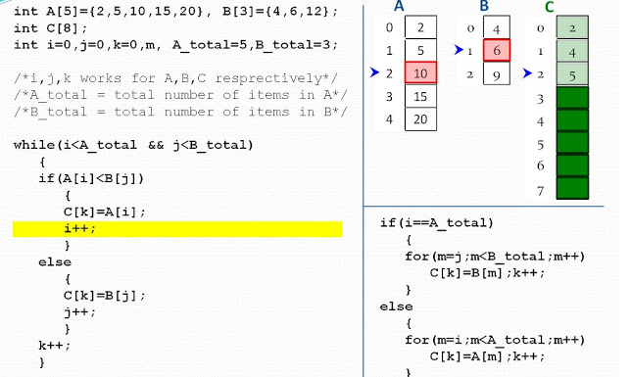
Create a 3 element double array & Initialize it using assignment??

Slide 29
Returning An Array From A Method
public static double[] returnArray( ) {
double[] x;
x = new double[3]; // Create an array of 3 elements
x[0] = 2.3;
x[1] = 3.4;
x[2] = 4.5;
return( x ); // Return the **reference** (location) of the array
}
Write the main method code

